Slide 1
Flying Man
By: Ryan Brasington, Pierre Grant, and Wasee Sameen

Slide 2
Game Background
Joe was once a normal man until he was framed for a crime and sentenced to Pixie Prison.
Joe couldn’t take it any more and escaped.
His future lies in your hands.

Slide 3
Game
The purpose of the game is to get passed the prison bars.
If the character hits one of the bars the player loses and a game over screen will appear.
If the player is able to get a higher score a message will appear.

Slide 4
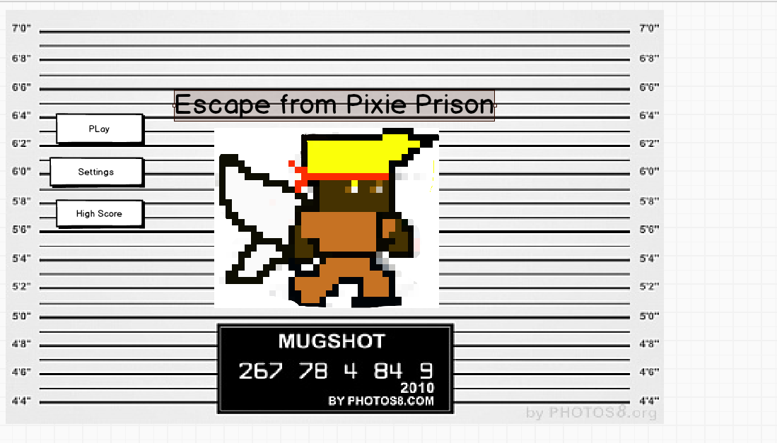
Layout

Slide 5
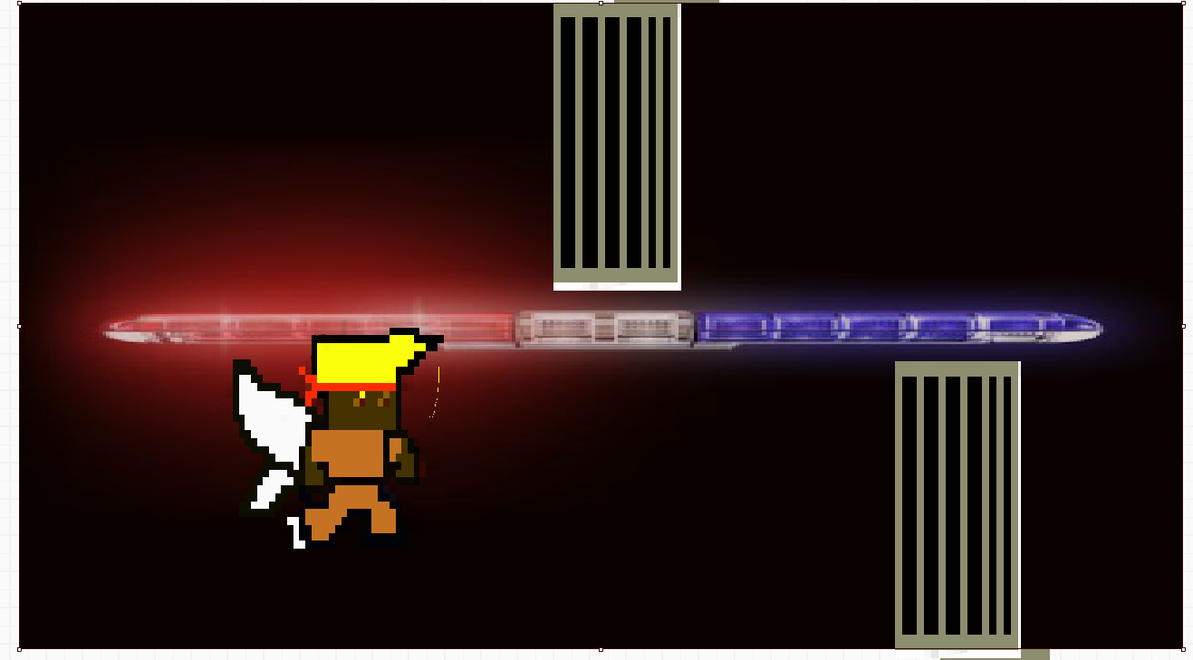


In Action

Slide 6
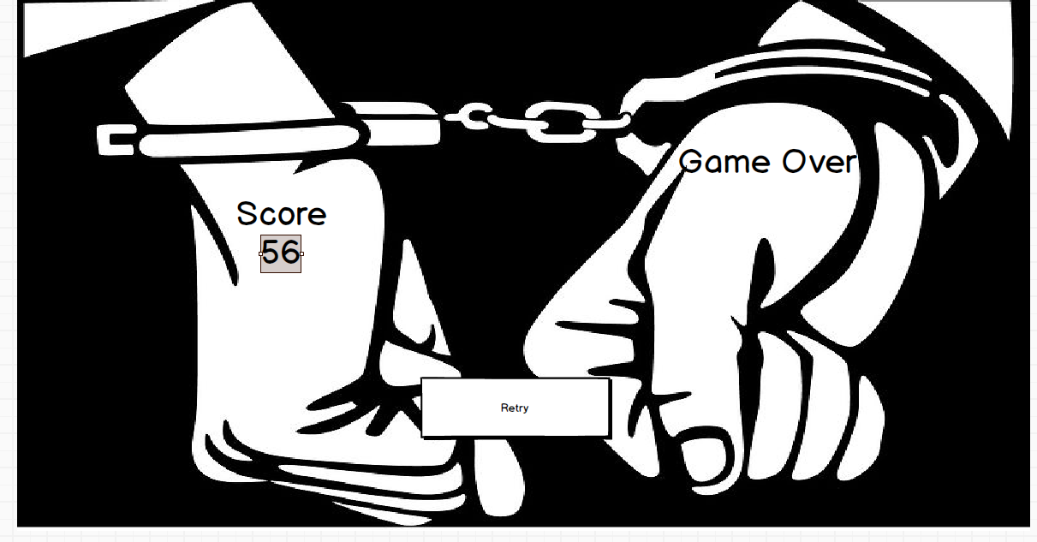
Game over

